Slide 1



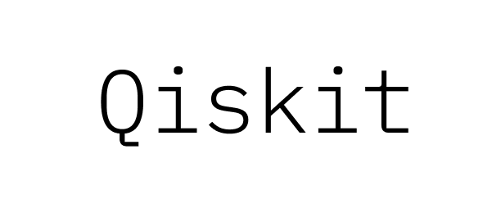

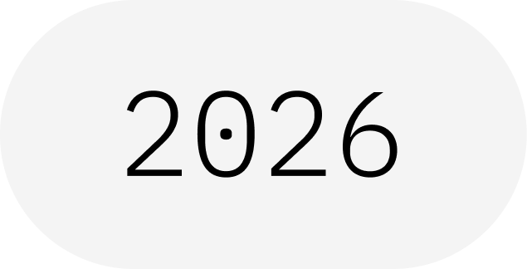
The Bloch Sphere
A Beginner's Walkthrough — the Bloch Vector and Quantum Gates
IBM Quantum School
Saad Ejaz • Guest Speaker
Qiskit Fall Fest 2026 at University of Engineering & Technology Lahore,Narowal Campus

Slide 2
01
SPEAKER INTRODUCTION
Saad Ejaz
Guest Speaker
Computer Engineering student and IBM Quantum School tutor, sharing a beginner-friendly introduction to the Bloch sphere, qubit states, measurement, and quantum gates.
IBM Quantum School
Qiskit Fall Fest 2026 at University of Engineering & Technology Lahore,Narowal Campus

Slide 3
02
02
03
04
05
06
02
TABLE OF CONTENTS
01
Introduction
02
The Bloch Sphere
03
Measurement & Probability
04
Quantum Gates
05
The Mathematics
06
Putting It Together
Qiskit Fall Fest 2026 at University of Engineering & Technology Lahore,Narowal Campus

Slide 4
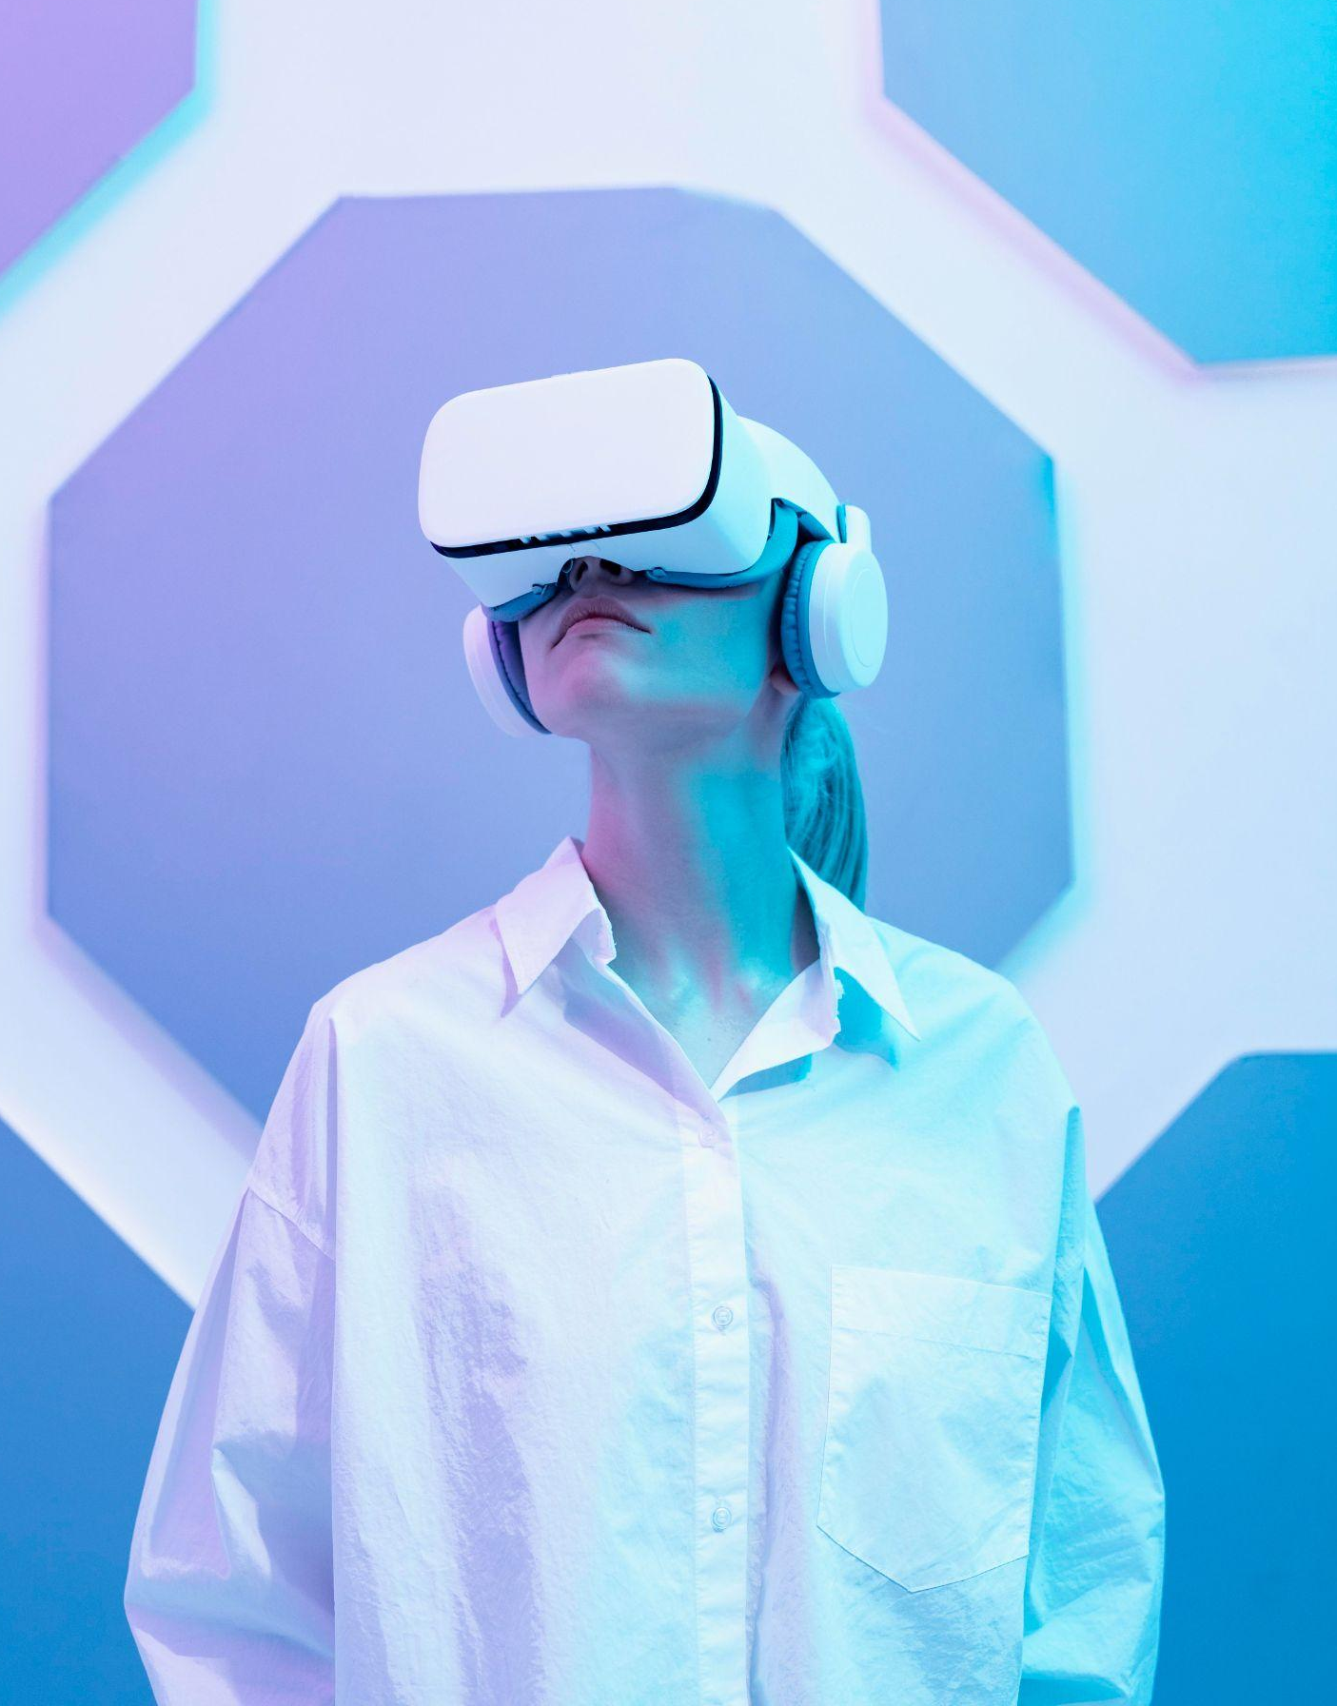
WHAT IS A QISKIT FALL FEST?
03
A beginner-friendly quantum computing session focused on how a single qubit can be visualized, transformed, and measured using the Bloch sphere.
Qiskit Fall Fest 2026 at University of Engineering & Technology Lahore,Narowal Campus

Slide 5
03
04
INTRODUCTION
01
Qiskit Fall Fest 2026 at University of Engineering & Technology Lahore,Narowal Campus

Slide 6
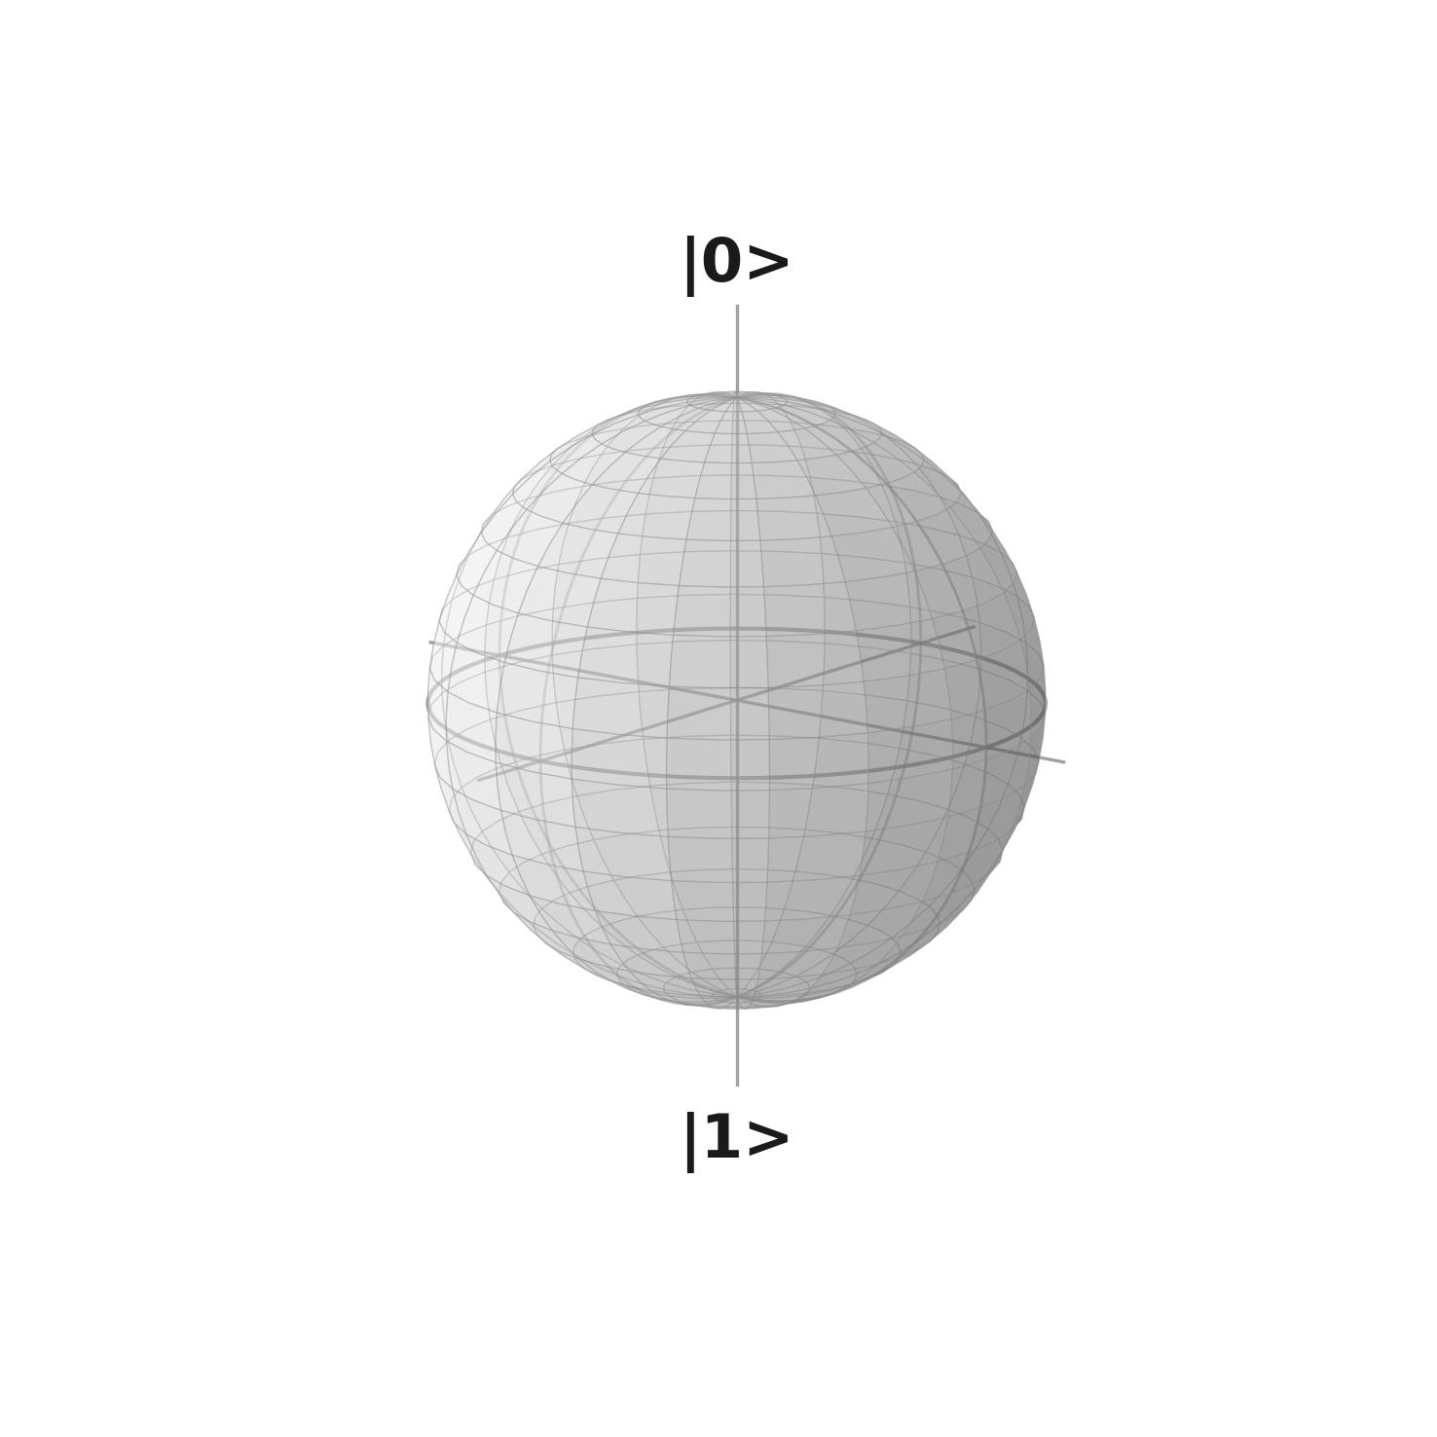
04
THE BLOCH SPHERE
A geometric picture of a single qubit
A qubit's state can be pictured as a needle pointing from the center of a sphere to its surface.
• Straight up → |0⟩
• Straight down → |1⟩
• Sideways or in-between → superposition
Qiskit Fall Fest 2026 at University of Engineering & Technology Lahore,Narowal Campus

Slide 7
05
THREE CORE IDEAS
WHAT IS IT?
WHAT DOES IT SHOW?
WHAT CHANGES IT?
A sphere used to visualize the state of a single qubit.
The needle direction tells us about the qubit's state.
Quantum gates rotate the Bloch vector to a new position.
Qiskit Fall Fest 2026 at University of Engineering & Technology Lahore,Narowal Campus

Slide 8
06
07
THE PICTURE
02
Qiskit Fall Fest 2026 at University of Engineering & Technology Lahore,Narowal Campus

Slide 9
07
KEY CONCEPTS
THE NEEDLE
THE SPHERE
Bloch vector
Bloch sphere
The qubit's state is represented by an arrow from the sphere's center.
The surface contains the possible pure-state directions.
THE POLES
THE EQUATOR
|0⟩ and |1⟩
Superposition
Up is |0⟩; down is |1⟩.
Sideways directions represent superposition states.
Qiskit Fall Fest 2026 at University of Engineering & Technology Lahore,Narowal Campus

Slide 10
08
FROM NEEDLE HEIGHT TO PROBABILITY
HEIGHT
BORN RULE
Top = +1 • Bottom = −1 • Sideways = 0
chance of 0 = (1 + height) / 2
REFERENCE POINTS
KEY IDEA
+1 → 100% chance of 0
0 → 50% chance of 0
−1 → 0% chance of 0
The height determines the 0/1 measurement odds.
Qiskit Fall Fest 2026 at University of Engineering & Technology Lahore,Narowal Campus

Slide 11
09
10
QUANTUM GATES
03
Qiskit Fall Fest 2026 at University of Engineering & Technology Lahore,Narowal Campus

Slide 12
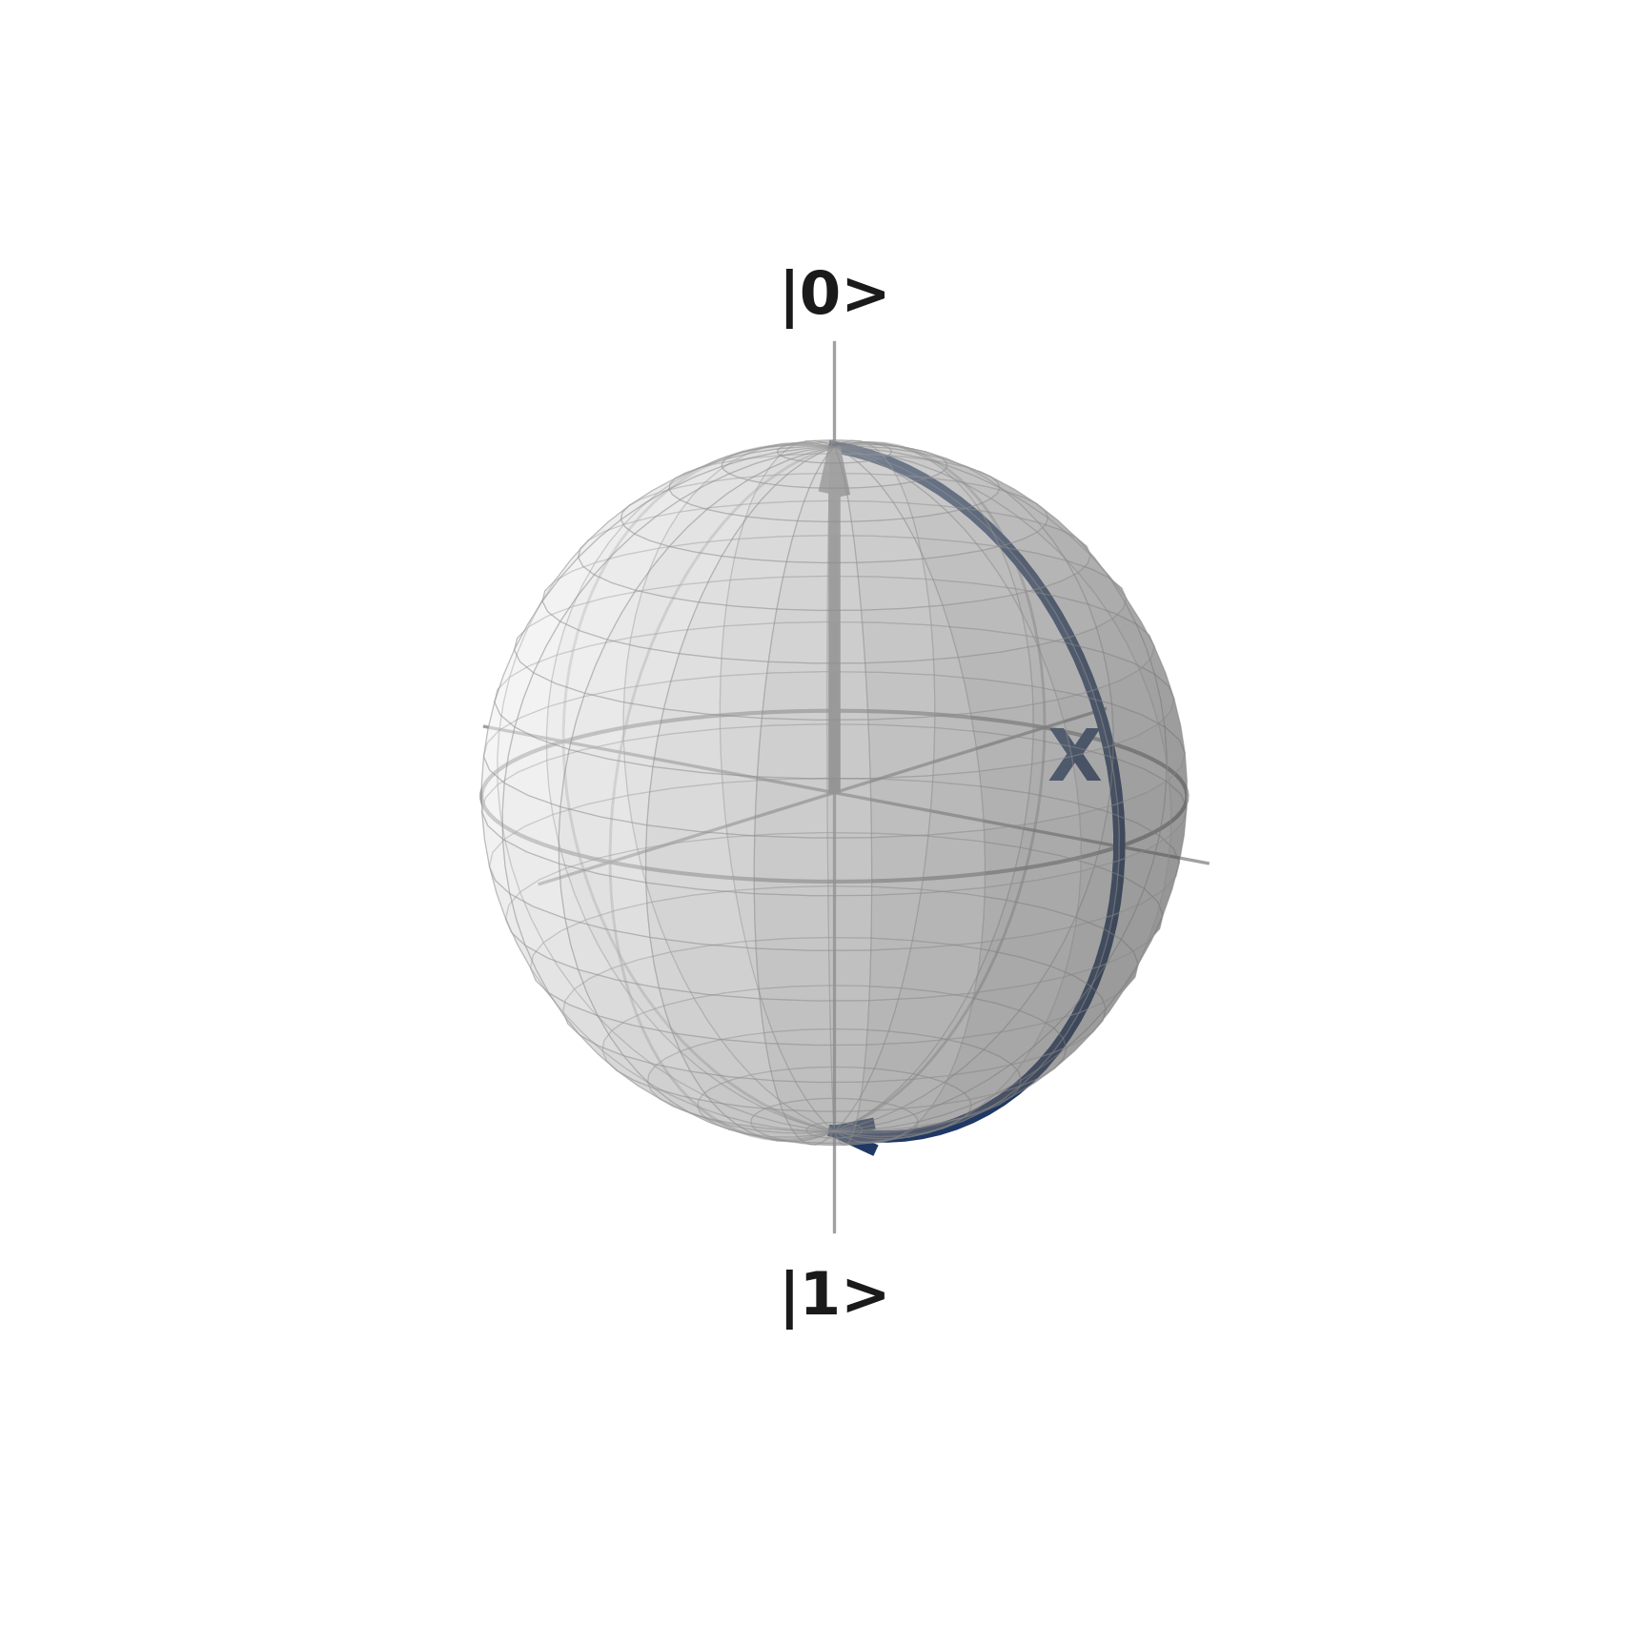
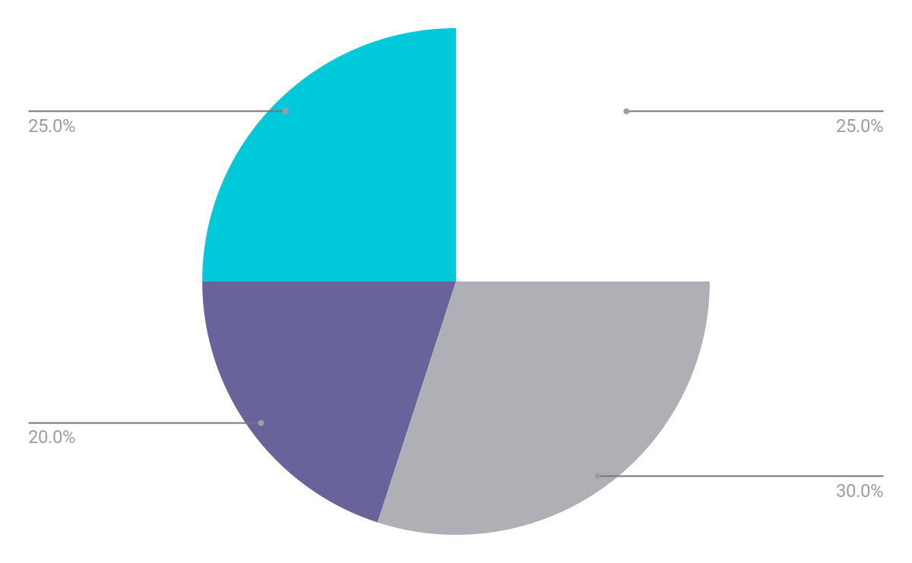
10
VISUAL REPRESENTATION
X GATE
Flips the needle to the exact opposite point.
|0⟩ → |1⟩
H GATE
Tilts the needle onto the equator, creating a 50/50 measurement split.
Qiskit Fall Fest 2026 at University of Engineering & Technology Lahore,Narowal Campus

Slide 13
11
MEASUREMENT: THREE REFERENCE POINTS
Needle position | Chance of 0 | Chance of 1
Straight up | 100% | 0%
Straight down | 0% | 100%
Sideways (flat) | 50% | 50%
Measurement makes the needle 'snap' to |0⟩ or |1⟩. The prior position determines the odds.
Qiskit Fall Fest 2026 at University of Engineering & Technology Lahore,Narowal Campus

Slide 14
12
13
PRACTICAL DEMO
04
Qiskit Fall Fest 2026 at University of Engineering & Technology Lahore,Narowal Campus

Slide 15
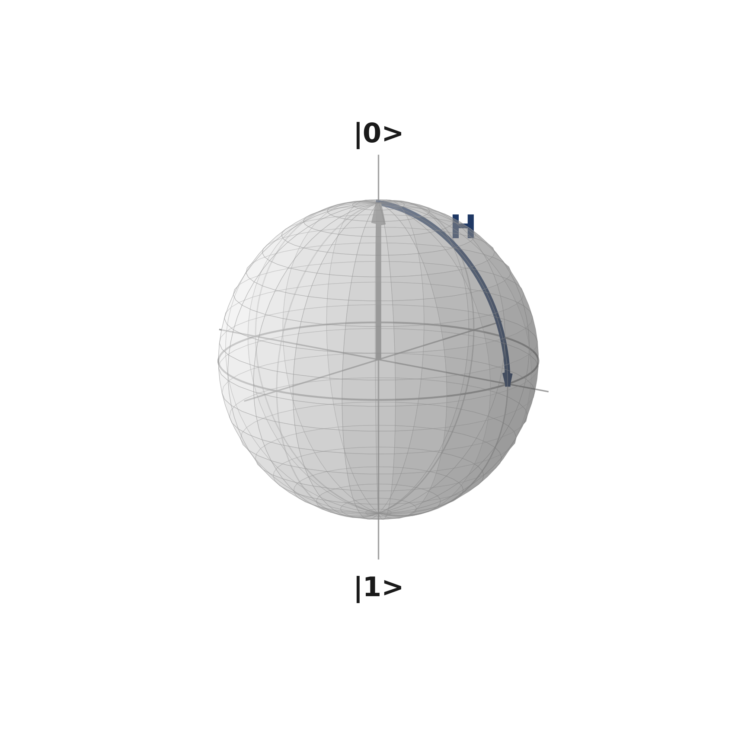
13
PRACTICAL DEMO
QISKIT CODE
WHAT IT SHOWS
from qiskit import QuantumCircuit
from qiskit.primitives import StatevectorSampler
qc = QuantumCircuit(1)
qc.h(0)
qc.measure_all()
sampler = StatevectorSampler()
result = sampler.run([qc], shots=1024).result()
print(result[0].data.meas.get_counts())
H prepares a superposition.
Measurement samples the qubit.
With many shots, the counts are close to a 50/50 split between 0 and 1.
Code pattern checked against IBM Quantum documentation.
Qiskit Fall Fest 2026 at University of Engineering & Technology Lahore,Narowal Campus

Slide 16
14
A SIMPLE GATE → MEASUREMENT WORKFLOW
|0⟩
H
Measure
Repeat
Start
Apply gate
Observe
Build evidence
Needle points up.
Needle moves to the equator.
State collapses to |0⟩ or |1⟩.
Many measurements reveal the probabilities.
Qiskit Fall Fest 2026 at University of Engineering & Technology Lahore,Narowal Campus

Slide 17
15
VOCABULARY MAP
The needle
→ Bloch vector
The ball
→ Bloch sphere
Straight up
→ Computational basis state |0⟩
Straight down
→ Computational basis state |1⟩
Snapping
→ Collapse upon measurement
Height → probability
→ Born rule
Qiskit Fall Fest 2026 at University of Engineering & Technology Lahore,Narowal Campus

Slide 18
16
17
THE MATHEMATICS
05
Qiskit Fall Fest 2026 at University of Engineering & Technology Lahore,Narowal Campus

Slide 19
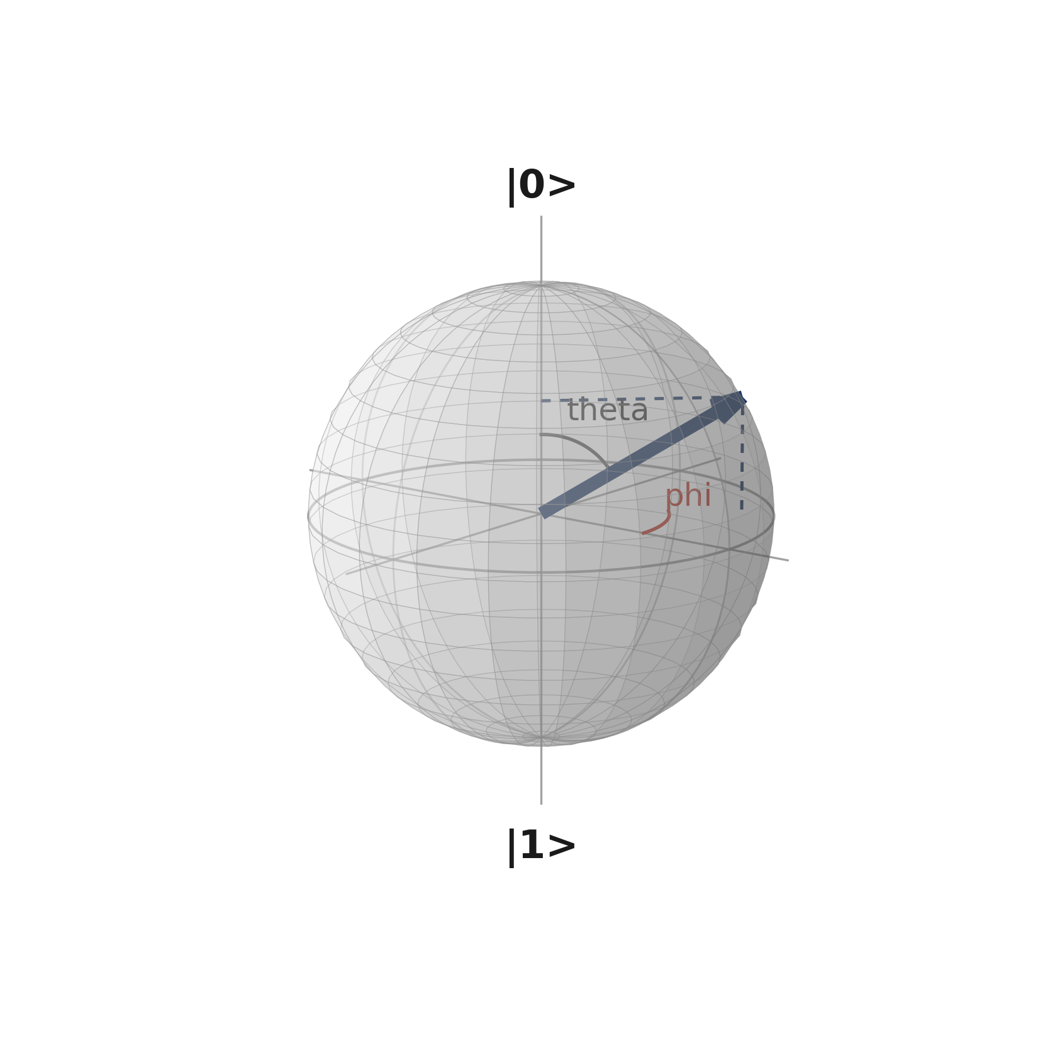
18
THE MATH BEHIND THE PICTURE
GENERAL SINGLE-QUBIT STATE
17
cos(θ/2)|0⟩ + e^(iφ) sin(θ/2)|1⟩
02
BLOCH-SPHERE COORDINATES
θ controls the tilt.
φ controls the twist around the vertical axis.
height (z) = cos(θ)
03
Qiskit Fall Fest 2026 at University of Engineering & Technology Lahore,Narowal Campus

Slide 20
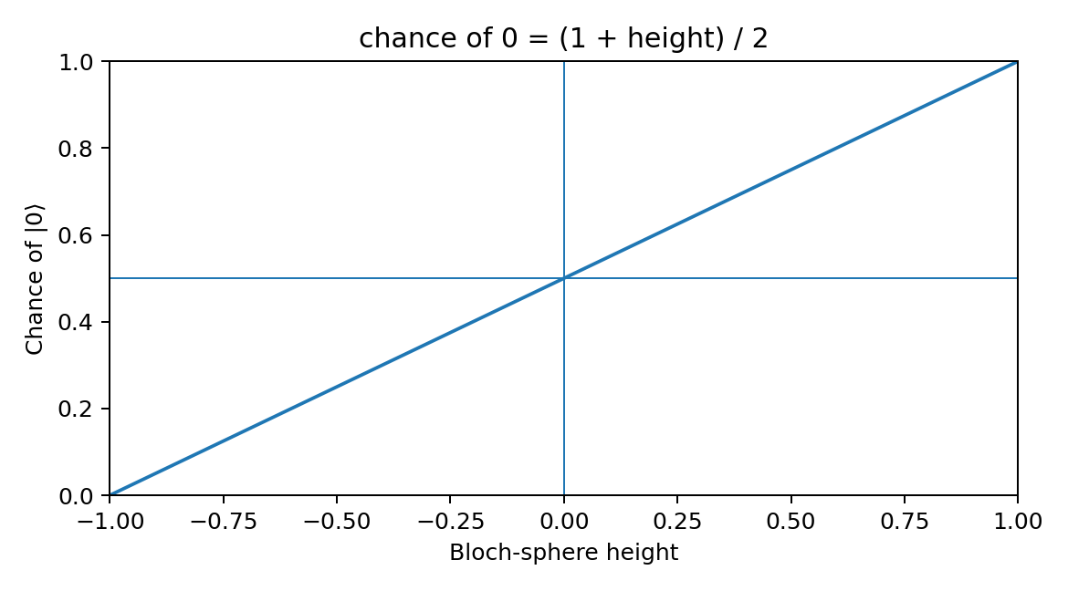
19
HEIGHT → CHANCE OF MEASURING |0⟩
18
02
03
+1 → 100%
0 → 50%
−1 → 0%
The vertical position of the Bloch vector directly determines the probability of measuring |0⟩.
Qiskit Fall Fest 2026 at University of Engineering & Technology Lahore,Narowal Campus

Slide 21
19
RESOURCES
SOURCE LECTURE
The supplied Bloch Sphere — Beginner's Walkthrough deck.
IBM QUANTUM DOCUMENTATION
Qiskit documentation used for the practical-demo code pattern.
KEY TAKEAWAY
The Bloch sphere turns qubit state, gates, and measurement into one visual picture.
Qiskit Fall Fest 2026 at University of Engineering & Technology Lahore,Narowal Campus

Slide 22
THANKS!
DO YOU HAVE ANY QUESTIONS?
20
Saad Ejaz • Guest Speaker
IBM Quantum School
Qiskit Fall Fest 2026 at University of Engineering & Technology Lahore,Narowal Campus

